Slide 1
Smart Street Light Monitoring System
By Sanidhya Shandilya

Slide 2
Introduction
Importance of Well-Designed Street Lighting:
Properly designed street lighting systems ensure safe and comfortable nighttime travel for pedestrians and vehicles, enhance neighborhood appearance, and reduce malfunctions during the night.
Inadequately maintained and outdated lighting systems in many areas result in poor visibility, wasting energy and financial resources, and posing a challenge for public authorities, especially in developing countries.

Slide 3
Proposed Street Light Monitoring and Control System:
The proposed system utilizes light sensors and current sensors in street light circuits to automatically switch lights on and off.
Light poles report problems to a centralized system via GSM modules, allowing efficient identification and repair of faulty lights, reducing response time.
Collected data is stored in a database, generating charts with information on power consumption, burning hours, interruptions, fault detection details, and actual locations of faulty street lights.
The system incorporates an optimal sleep scheduling protocol to increase the lifetime of street lights, making maintenance more efficient and cost-effective.

Slide 4
Benefits and Impact:
The proposed system significantly improves road safety, deters crime, enhances residents' quality of life, and contributes to the overall prosperity of the city by creating a secure environment and boosting businesses.
Individual faults can be repaired within a few working hours, a stark contrast to the lengthy process in the current system where faulty lamps are reported infrequently and repaired sporadically, often relying on resident or municipal employee reports.

Slide 5
MODULES
1.Sensor module:-Deals with the functioning of the sensors used in the project. The main function of the module is to make the street light works automatically(on and off and concept of bright and dim) based on the sunlight and the movement detected.
The Sensors used are as follows:-
1.LDR-Detection is based on threshold light of sun
Function is to make street light on and off on the basis of
light intensity of sunlight.
2.PIR-Detection of the movements on vehicles
Function is to make the street light Bright for certain time
and dim as no movement detected.

Slide 6
Use of the Sensor Module
Energy Conservation and Efficiency:
The implementation of the street light monitoring system, integrating advanced sensors detecting ambient light and motion, marks a significant stride in energy efficiency and environmental consciousness. By intelligently assessing light levels, the system ensures lights are active only when necessary, eliminating wasteful energy usage during daylight and well-lit periods. Motion sensors dynamically respond to pedestrians and vehicles, enhancing safety while conserving energy in inactive areas. This approach significantly reduces unnecessary power consumption, leading to economic savings and a reduced carbon footprint. Moreover, by conserving energy, the system aids in natural resource preservation and eases strain on power generation, fostering a more sustainable urban environment. In essence, this technology signifies a leap towards a greener, economically prudent future, promoting safety, reducing costs, and contributing to a cleaner world.

Slide 7
2.Communication Module:-
Wireless Connectivity: The communication module enables wireless connectivity between street light controllers, sensors, and the central server, allowing seamless data exchange and control commands.
Data Transmission: It facilitates the transmission of sensor data, such as light levels and motion detection, from individual street light controllers to the central server in real-time, ensuring accurate monitoring and analysis.
Remote Control: The communication module allows remote control of street lights, enabling administrators to adjust lighting schedules, brightness levels, and other settings without manual intervention, enhancing operational flexibility.
Fault Reporting: In case of malfunctions or issues, the communication module sends instant alerts to the central server, enabling rapid response and minimizing downtime. This proactive approach aids in efficient maintenance.
Two-way Communication: The module supports two-way communication, allowing the central server to send commands back to street light controllers. This bidirectional communication ensures precise control and monitoring capabilities.

Slide 8
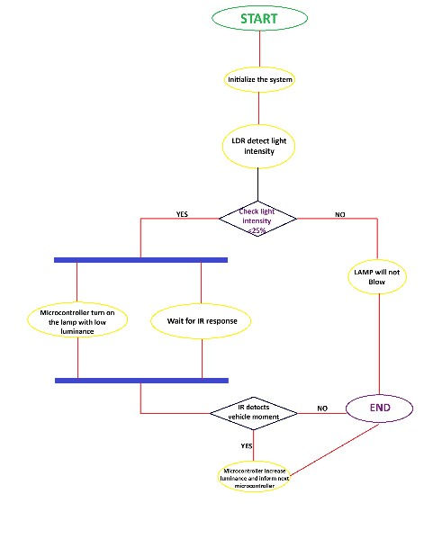
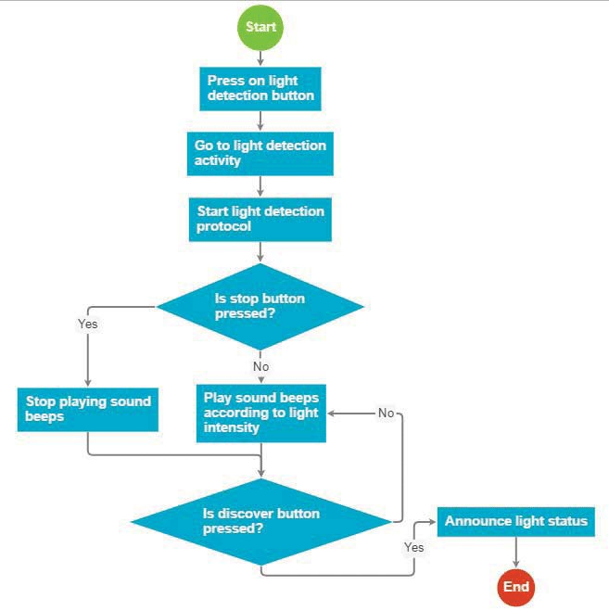
ACTIVITY DIAGRAM

Slide 9
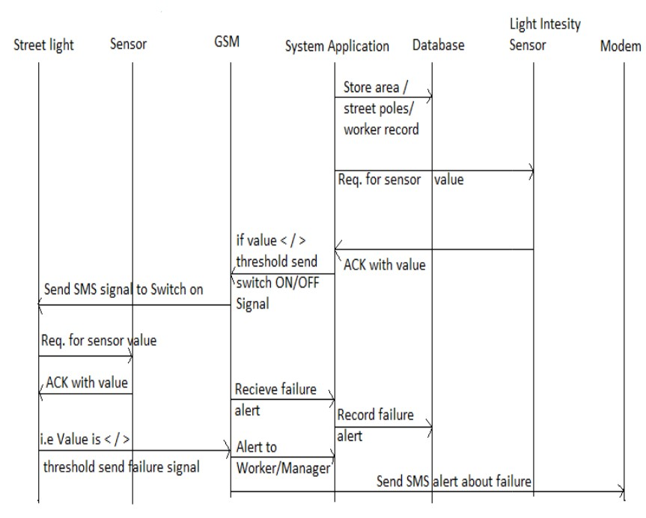
Sequence diagram

Slide 10
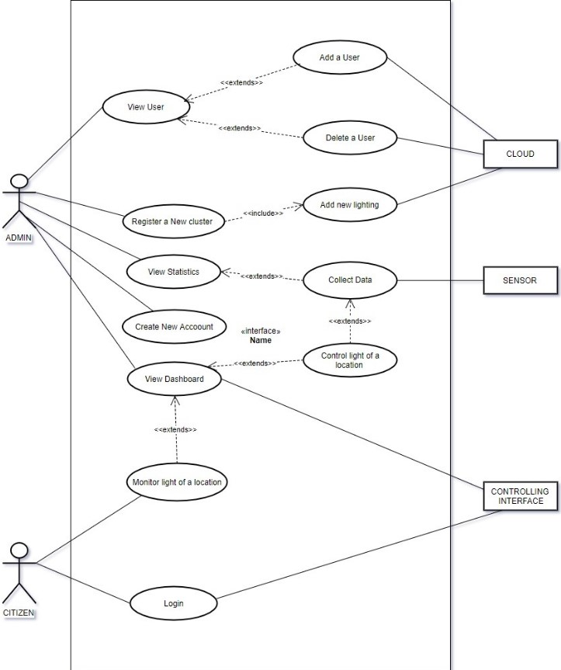
Use case diagram

Slide 11
Literature
Power Conservation through LDR Sensors and Microcontrollers:
First project focuses on energy conservation by utilizing LDR sensors and microcontrollers.
Street lights remain off during daylight hours when light levels are sufficient, saving energy by avoiding unnecessary illumination.
Automated Operation with LDR and Photoelectric Sensors and PIC16F877A Microcontroller:
Second project eliminates manual operation by integrating LDR and photoelectric sensors with a PIC16F877A microcontroller.
System automatically adjusts lighting based on ambient light levels and detects street movement, ensuring efficient illumination without manual intervention.
Intelligent Street Lighting (ISL) with LED Lamps and Wireless Technology:
Third project introduces Intelligent Street Lighting (ISL) using LED lamps and wireless technology.
Offers a flexible and energy-efficient solution by swiftly adapting to light requirements, conserving power while meeting lighting needs in urban areas.
Smart Street Light Control with GSM Technology:
Fourth project implements GSM technology for smart street light control.
Client-side GSM modem connects to a microcontroller, enabling timed switching of street lights.
Server-side, managed by another GSM modem, facilitates control through a Monitoring and Control Application, reducing waste and enhancing energy efficiency in urban lighting.

Slide 12
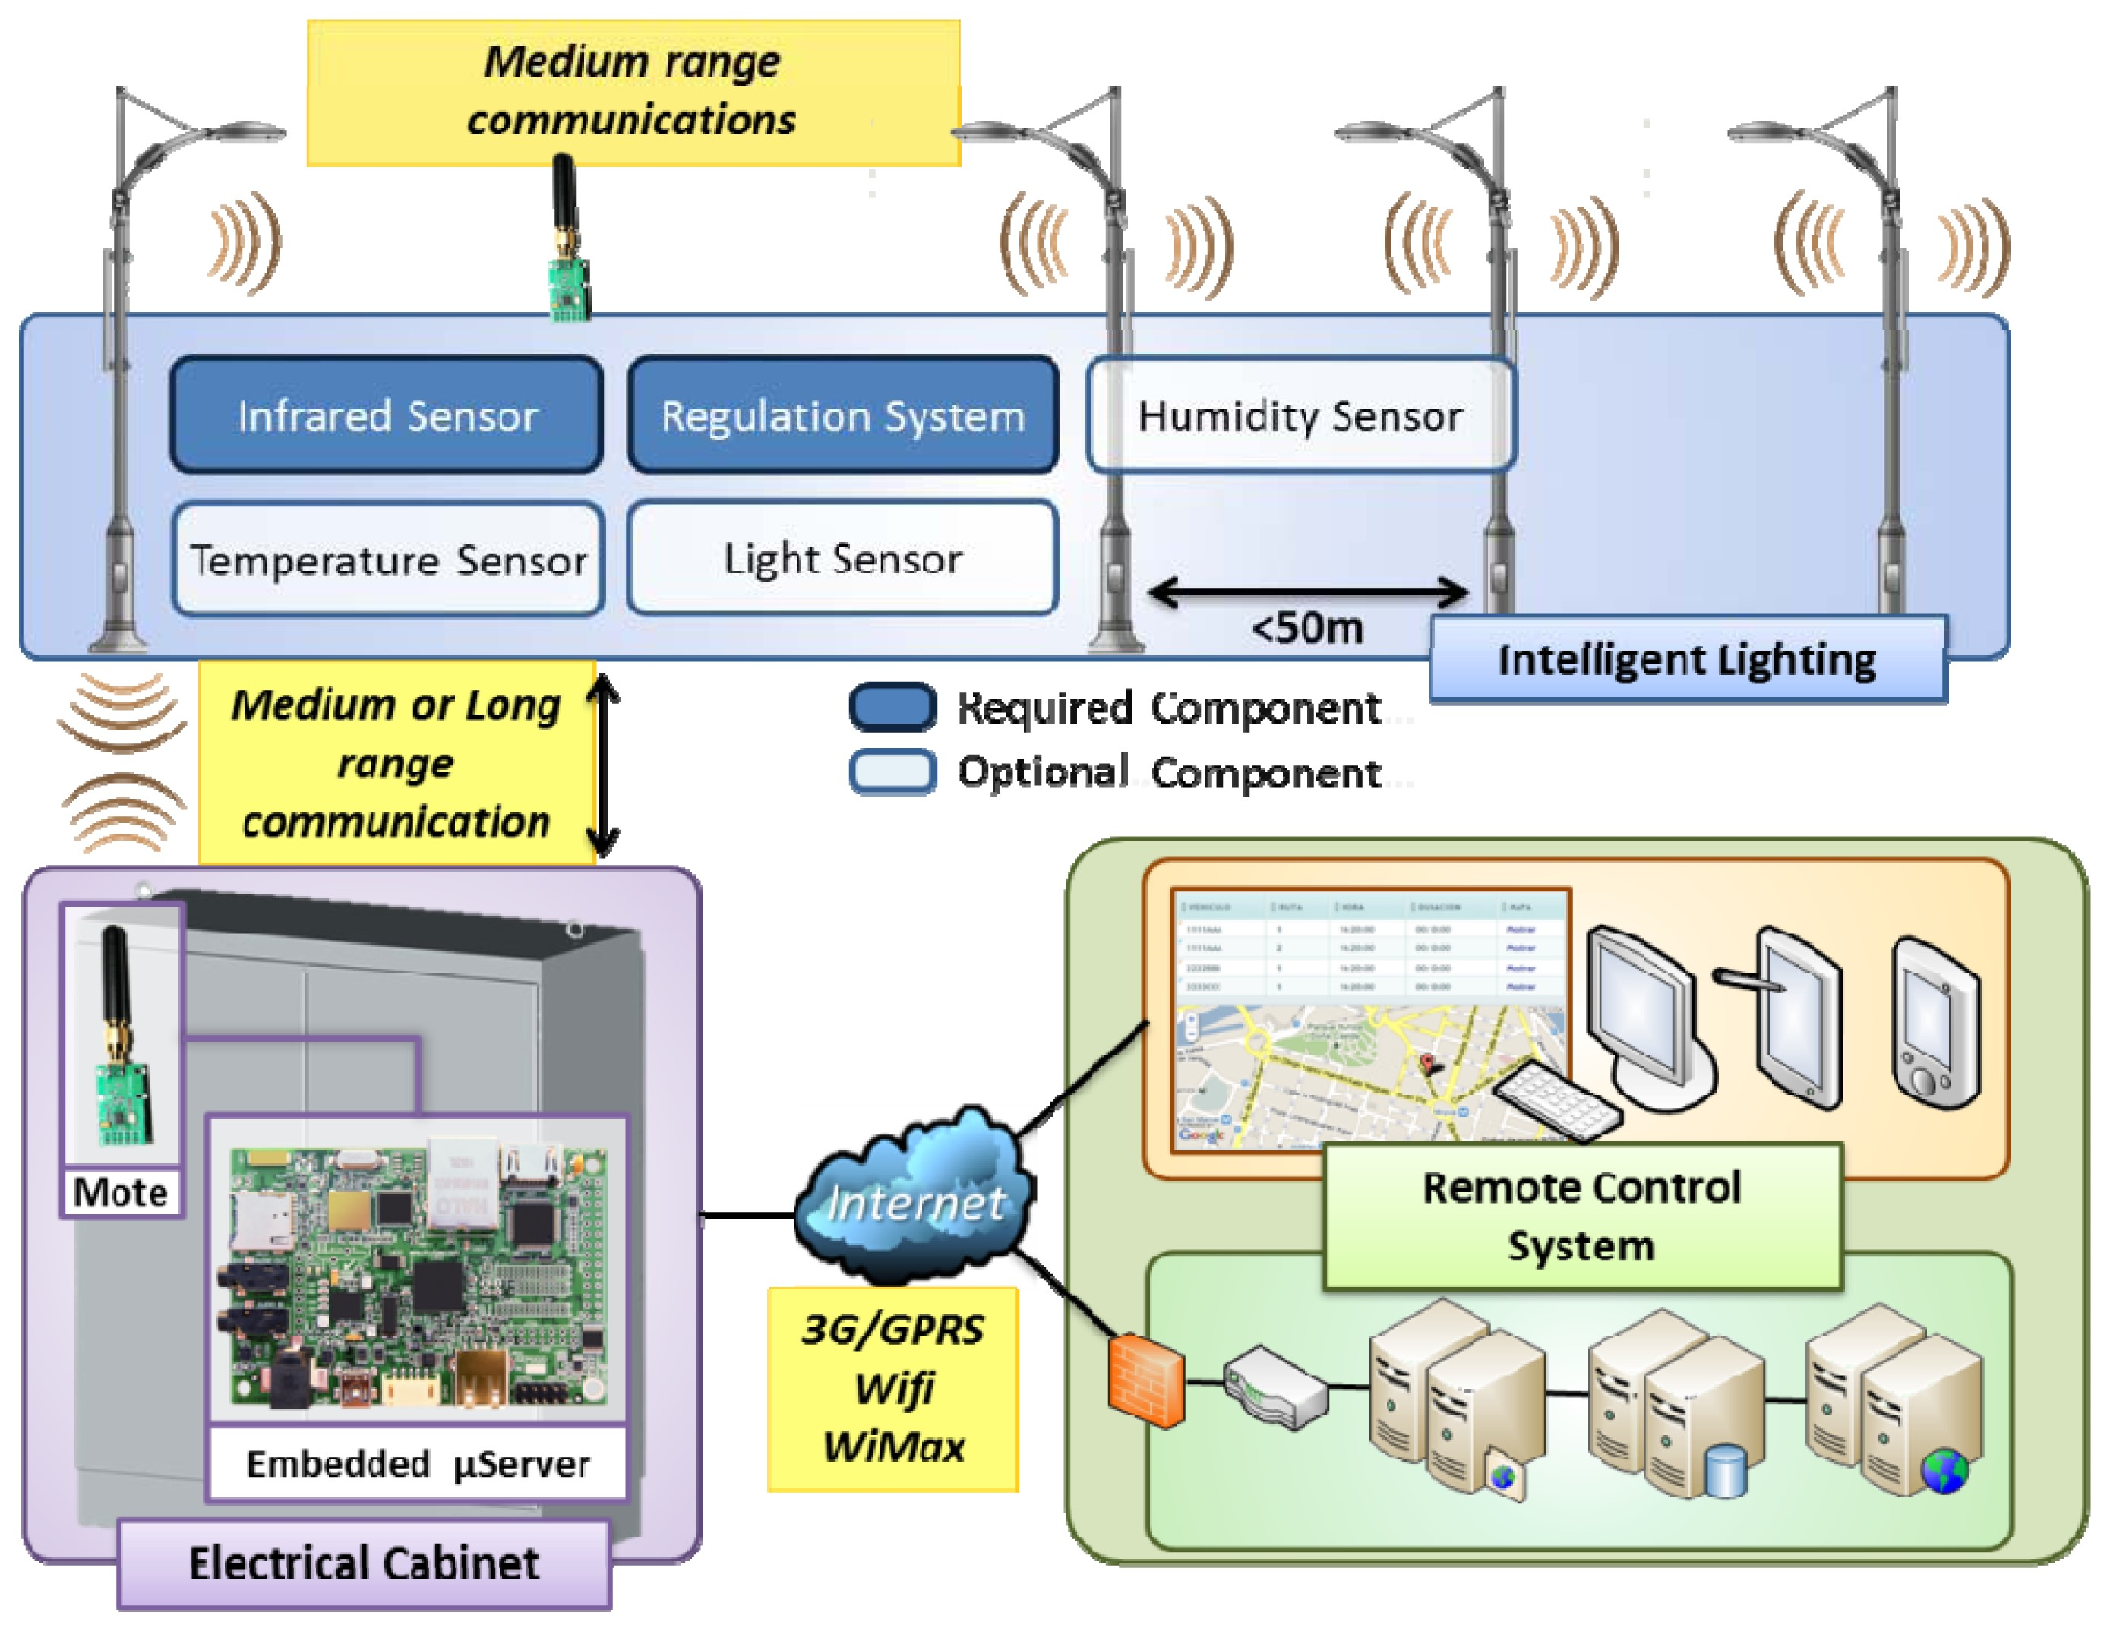

Slide 13
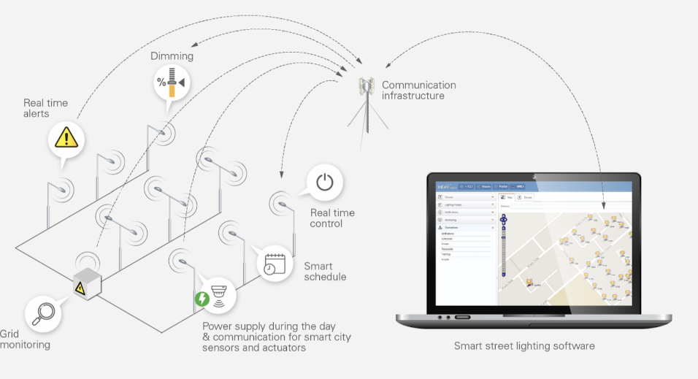

Slide 14
Literature
Ref with year | Authors | Method/ technology
[1] 2019 | M. B. Kodad, A. Akherraz, A. El Habbani | This paper explores IoT-based solutions for street light control systems, providing insights into the integration of IoT technology for efficient monitoring.
[2] 2017 | A. Alwisy, A. Nasr, A. Ghuniem | This paper discusses the design and implementation aspects of a smart street lighting system, covering various sensors and control mechanisms.
[3] 2014 | A. S. Suryawanshi, M. V. Aware | The paper explores the integration of GPRS and web technology for intelligent street lighting, emphasizing remote monitoring and control.

Slide 15
Results
1.Energy Conservation:
Measure and present the energy savings achieved through the implementation of the street light monitoring system.
Provide data on reduced power consumption during off-peak hours and the overall impact on the energy grid.
2.Fault Detection and Maintenance:
Highlight the system's effectiveness in detecting faulty street lights and its ability to report issues in real-time.
Present statistics on the average time taken to identify and repair faulty lights before and after the implementation of the monitoring system.

Slide 16
Discussions
Energy Efficiency and Environmental Impact:
Discuss the environmental benefits of reduced energy consumption, including decreased carbon emissions and lower electricity bills.
Analyze the long-term environmental impact of the system, considering reduced light pollution and its positive effects on the local ecosystem.
2.Operational Improvements:
Discuss how the system's automation has led to operational improvements, including reduced manual interventions and lower maintenance costs.
Explore the system's adaptability to different weather conditions and how it contributes to overall urban safety and aesthetics.

Slide 17
Conclusion
1.Energy Conservation and Efficiency:
The system has successfully optimized energy usage by automatically adjusting street lights based on ambient light levels and motion detection, significantly reducing unnecessary power consumption during off-peak hours. This has led to substantial energy savings and a positive environmental impact by decreasing carbon emissions.
2. Operational Streamlining:
By automating the monitoring and control of street lights, the system has streamlined operations, eliminating the need for manual interventions. Real-time fault detection and prompt repairs have reduced downtime, ensuring well-lit streets consistently. This has not only enhanced urban safety but also reduced maintenance costs significantly.

Slide 18
References
[1] SAKSHEE SRIVASTAVA,’ AUTOMATIC STREETLIGHTS’.
[2] V.V.S.Madhuri, P.Mallikarjuna Sarma,.N.SandhyaRani, ’Automatic Street Lighting usingPLC’.
[3] Prof. K.Y.Rajput, Gargeyee Khatav, Monica Pujari, Priyanka Yadav,’ Intelligent Street Lighting System Using Gsm’.
[4]Omkar Natu, Prof.S.A.Chavan,’GSM based smart street light monitoring and control system’.
[5]R. Caponetto*, G. Dongola*, L. Fortuna*, ‘Power Consumption Reduction in a Remote Controlled Street Lighting System’, SPEEDAM 2008 International Symposium on Power Electronics, Electrical Drives, Automation and Motion.
[6] A. Lay-Ekuakille, G. Vendramin,’Led-based Public Lighting System Reliability for a Reduced Impact on Environment and Energy Consumption’.
[7] R.Rubanath,T.Kavitha ‘GSM Based RFID Approach To Automatic Street Lighting System’30th April 2012
[8] M. A. Wazed, N. Nafis, ‘Design and Fabrication Of Automatic Street Light Control System’, Engineering e-Transaction Vol. 5, No. 1, June 2010
[9] RadhiPriyasree; RafiyaKauser.H; Vinitha.E; Gangatharan.N,’Automatic Street Light Intensity Control and Road Safety Module Using Embedded System’, (ICCCE 2012), 12 & 13 April, 2012.

